Slide 1
Updating report content by using Text file

Slide 2
HTML source code
We can use the following code to place the text file data in the results field of report .
The code as follows
<div class="container”>
<div class=“txt-style">
<div class="col-md-4">
</div>
<div class="col-md-8">
<object data="section1.txt">
</object>
</div></div></div>

Slide 3
Text file data (section1.txt)
The section1.txt file is placed in the below location please check the below
“Dropbox\0119 Programming\Riser-And-Mooring-Feasibility-Analysis-Report\Section1.txt"

Slide 4
CSS style
.txt-style {
background-color:pink;
color:#fff;
font-size:20px;
}
The style class provided above that we couldn’t apply to the report page.

Slide 5
Structural schema for updating report
Input text file → HTML Page → Report output
Internal process in structural flow:
Text File
(User Entered Data)
Conversion
[We are using html code to convert text data into HTML data.
In this process styling can be applied only to entire part but not on specified part]
HTML File
We use some HTML code to fetch the data from the text file
Report Output
Fetched output data can be retrieved in report and output is viewed in the browser
Can we execute a Python code here?

Slide 6
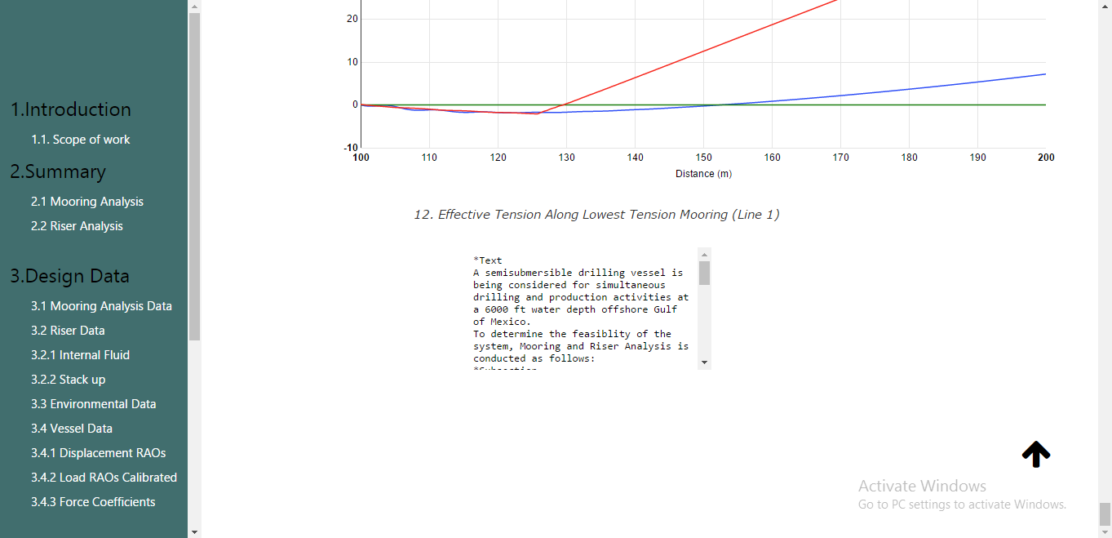
Report output
Obtained output in the browser is shown below image.
Please give us your suggestions

